Slide 1

Customer Churn Prediction
End-to-End Machine Learning Modeling Project
453 Application Domains
Individual Assignment
Shaolong (Fred) Xue

Slide 2
Business Questions
What are the main factors contributing to customer churn?
How do we predict churn for existing customers?
How should we intervene with the most effective retention strategies?

Slide 3
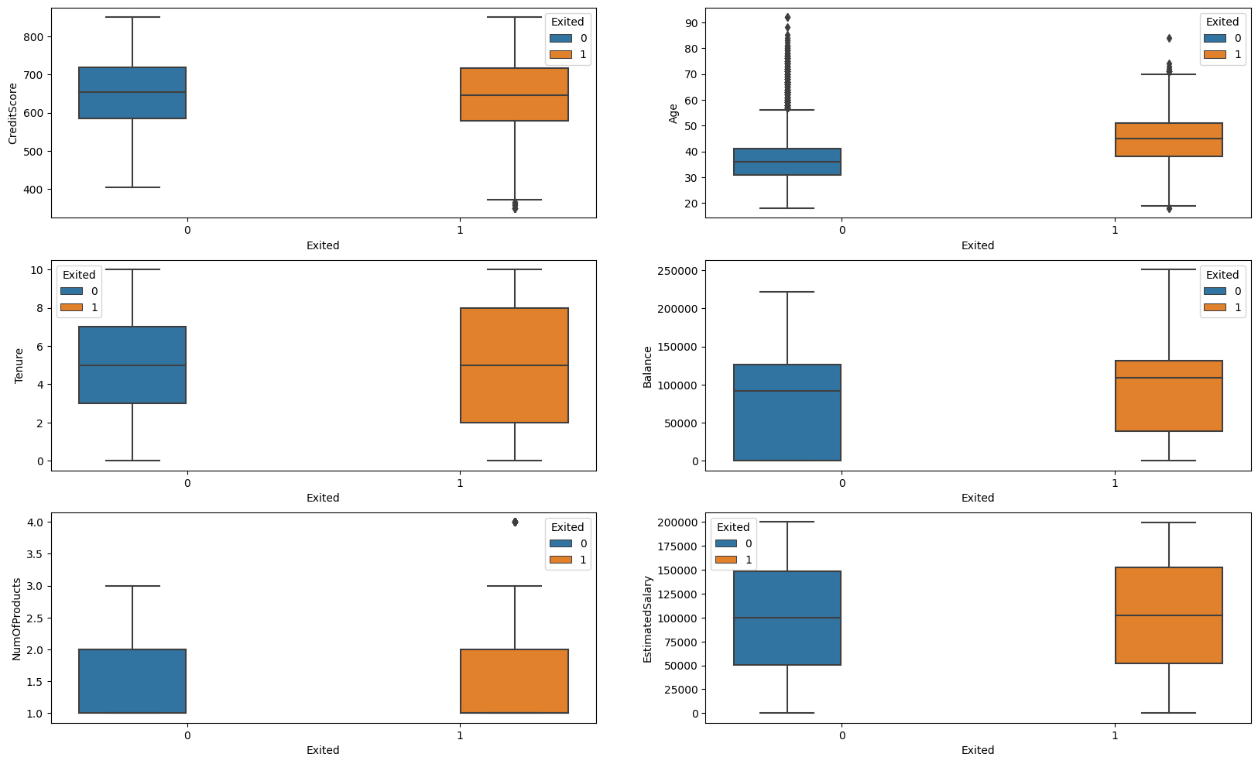
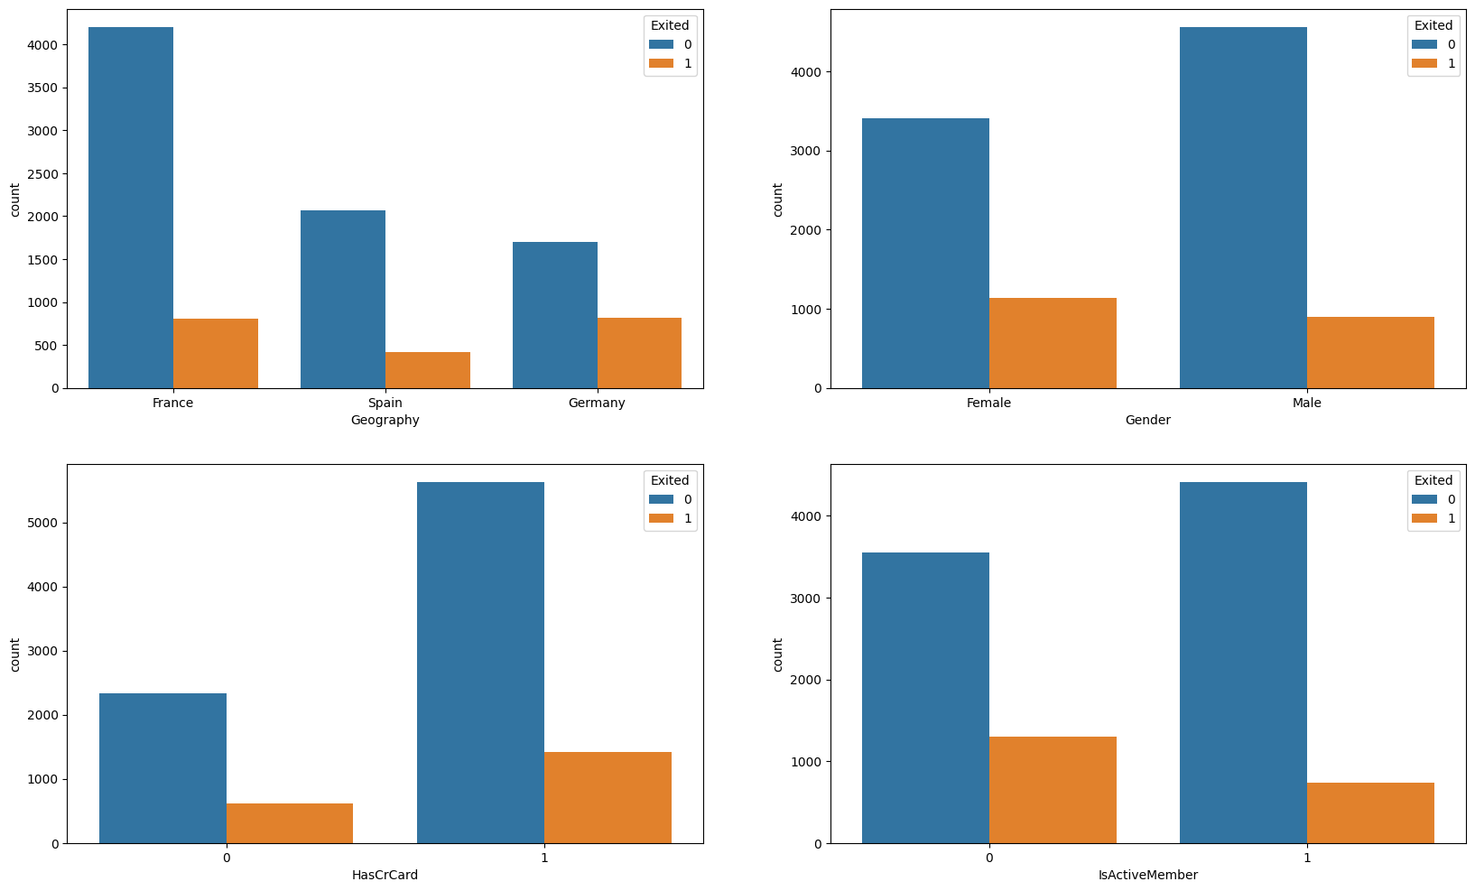
Data and EDA
Bank Customer Churn Data:
https://www.kaggle.com/code/linastianbao/bank-churn-prediction/input
10000 x 14
20.37% churned. 79.63% not churned
Gender
Credit Score
Age
Geography
Tenure
Balance
Membership
CC Ownership
# of Products
Salary
Categorical Variables
Continuous Variables

Slide 4
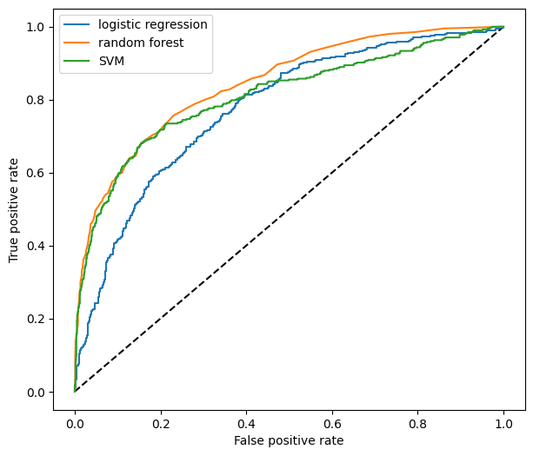
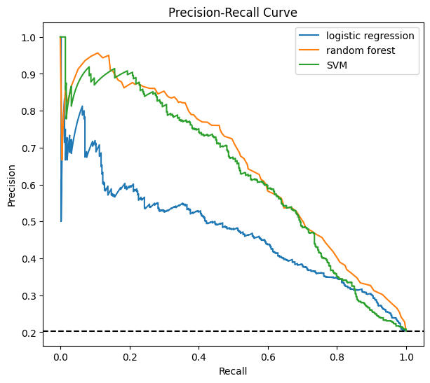
Modeling Insights
Top 5 Importance Features:
Age
Credit Score by Age
Number of Products
Credit Score
Balance
RF Performance
Accuracy = 0.86
Recall = 0.46
ROC = 0.84
AUC = 0.65
Fitted three models:
Logistic Regression
Random Forest (Best)
SVM

Slide 5
Business Actions
Retention Campaign
Customer Segmentation
A targeted retention campaign aimed at customers who are identified as being at high risk of churning by the model.
Offer incentives such as personalized discounts, loyalty rewards, or additional services to encourage these customers to stay.
Improved Data Collection
Model performance can be improved by collecting additional data on customer behavior and preference, such as transaction history, customer service interactions, and demographics. This could improve the mode’s predictive ability and identify additional factors that contribute to customer churn.
Cost Benefit Analysis
The bank could use the prediction to segment their customer base into high-risk and low-risk groups. This allows the bank to focus their retention efforts on the customers who are most likely to churn and prioritize their resources accordingly.
Perform a cost-benefit analysis to determine the potential financial impact of customer churn and the cost of retention effort
Help the bank make informed decisions about how much to invest the retention efforts and which customers to target

Slide 6

Business Outcome
Retention Campaign
Improved Retention
Customer Segmentation
Improved Data Collection
Higher Predictive Power
Cost Reduction
Effective Targeting and Prioritization
Cost Benefit Analysis
Higher revenue
Complete and Comprehensive Customer Data
Cost-effective campaigns

Slide 7
Conclusion
Overall, the bank can use the model’s predictions to identify customers who are at risk of churning, and take targeted actions to retain them.
By doing so, the bank can reduce the number of customers who churn and increase customer loyalty and profitability.

